Slide 1
Team papa ka para
Aditya Raghuvanshi Utsav Shekhar

Slide 2
Our hypothesis
There are some languages which are perceived more soothing / more beautiful to humans.
In Indian context we found 2 such languages, Urdu and Bengali. Our main focus here will be on trying to find the reason behind why Urdu is perceived more soothing to humans than other Indian languages
Other such languages are 1. French
Chinese/Mandarin Vs Japanese ( Yash Bhaskar )

Slide 3
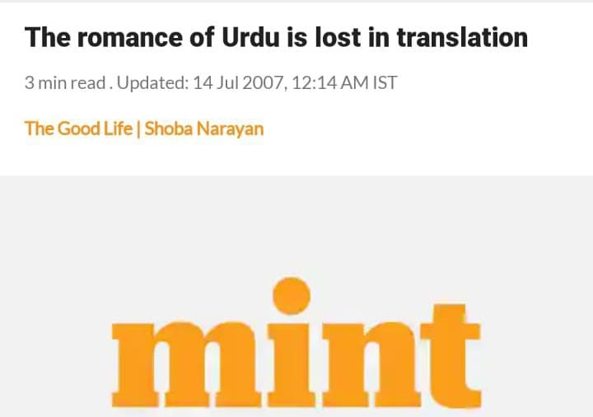

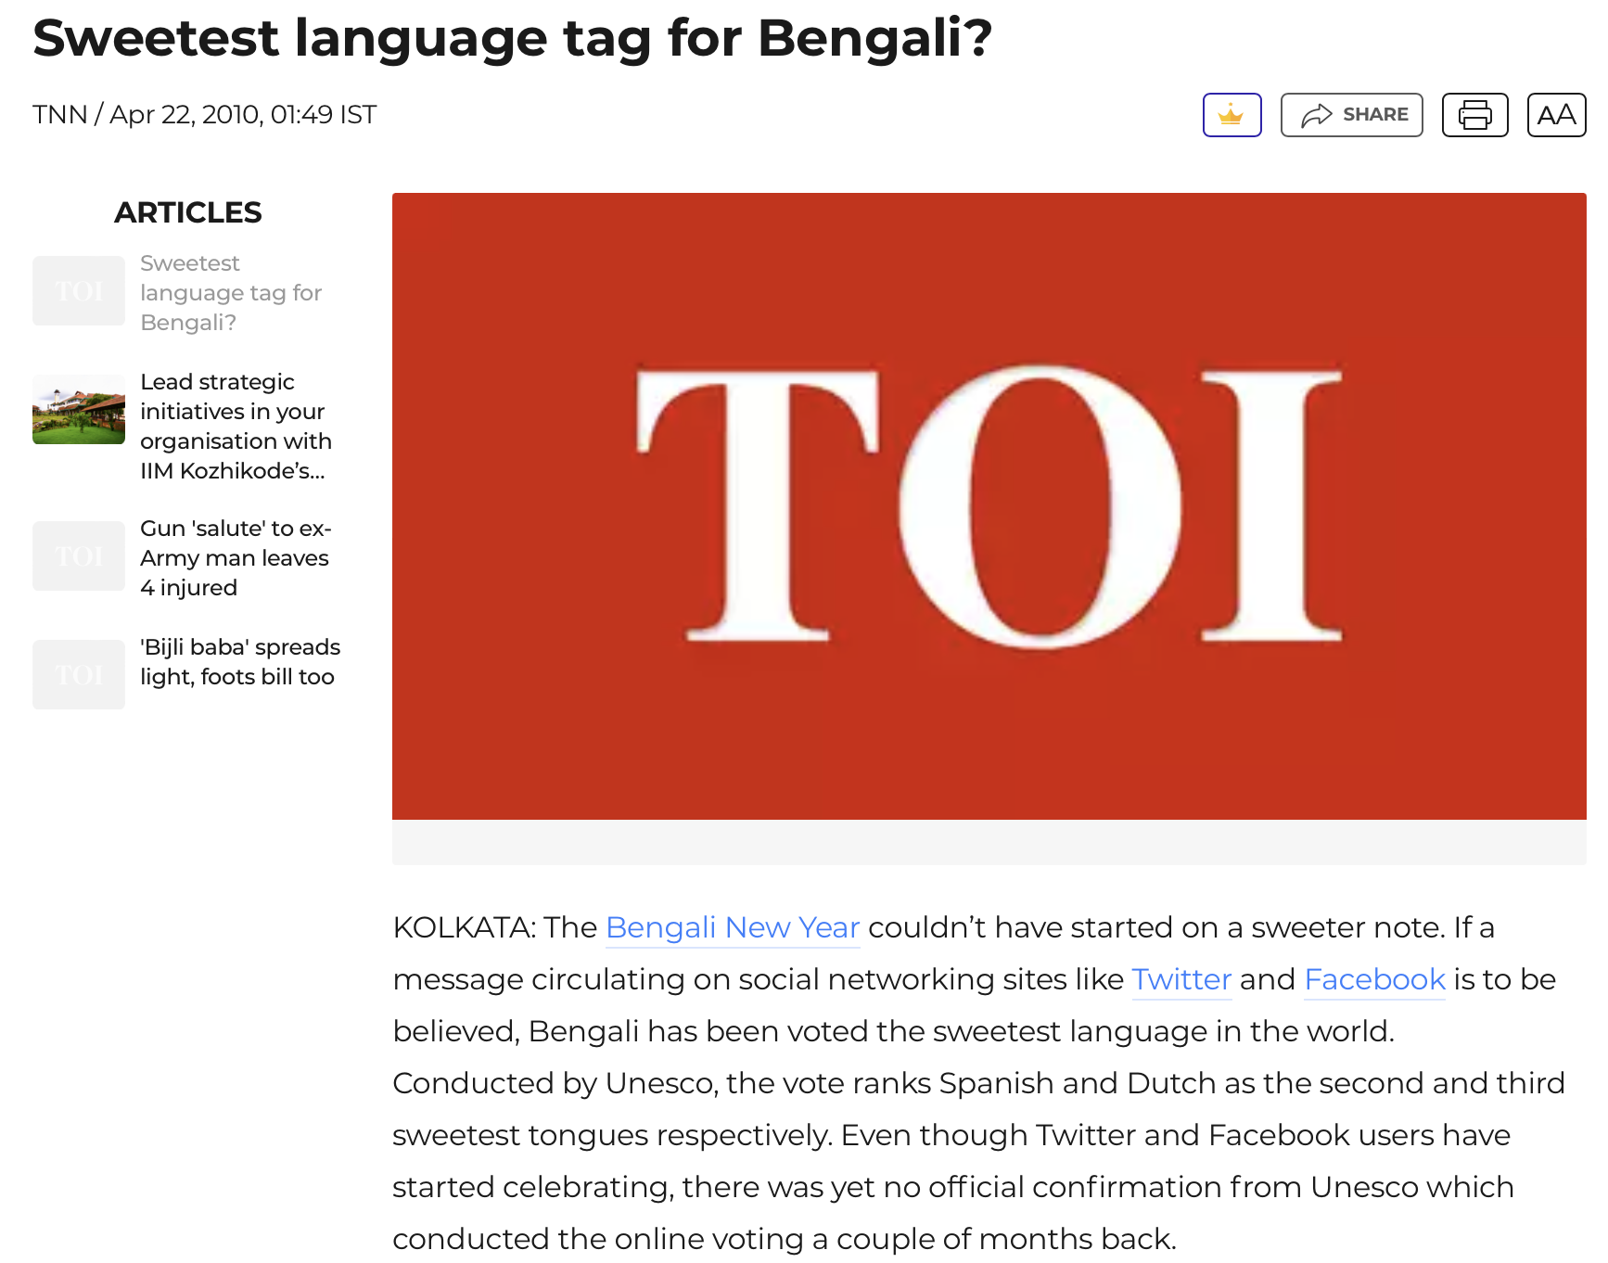

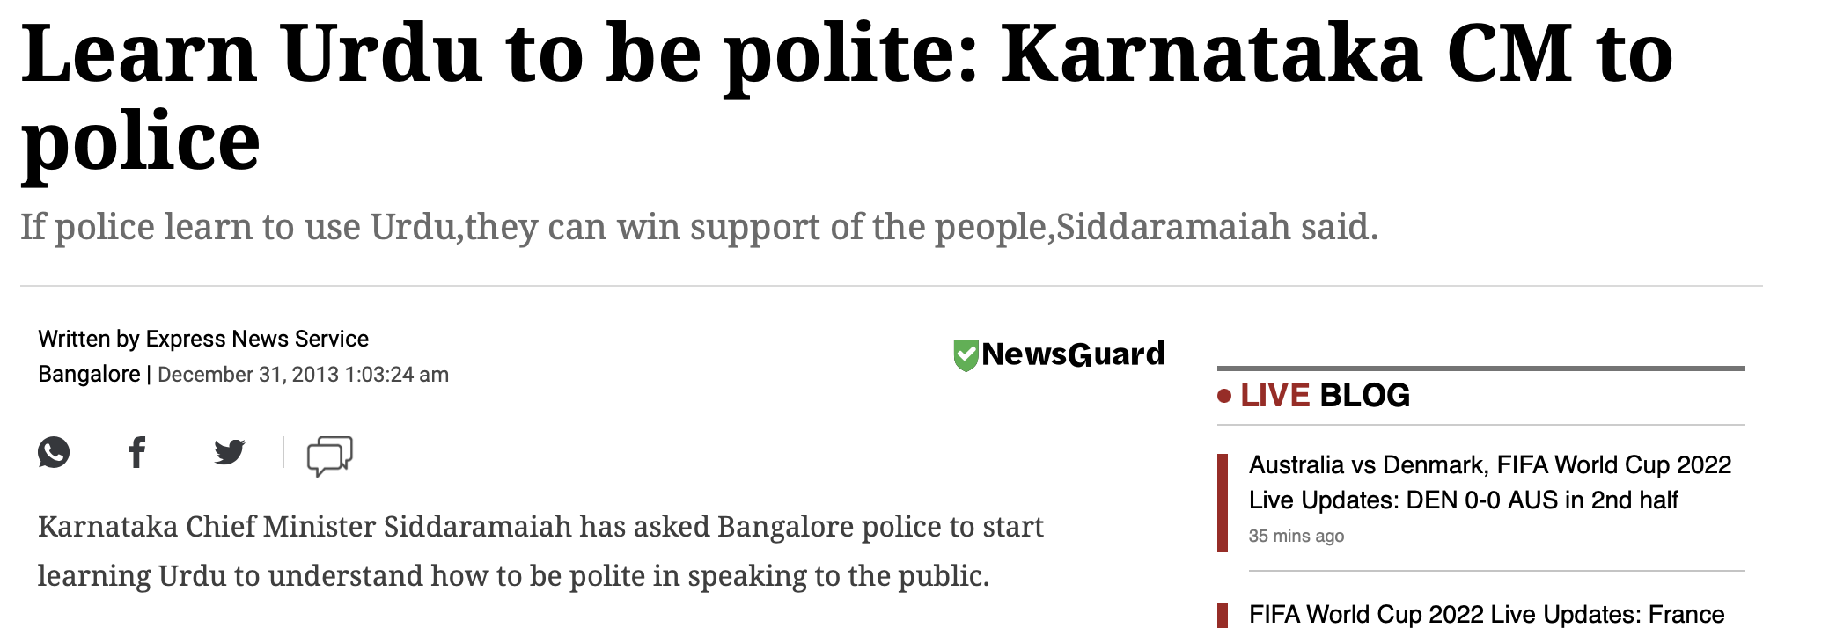
Motivation
Yash Bhaskar effect

Slide 4
Our approach
So we knew that something is going on which we are not able to understand why
We divided our total approach into 3 methods:
Stage 1 : Did a survey to find the effect of translation factor in feelings or emotions. Does it get reduced or changed due to translation?
Stage 2 : Detailed analysis based on phonological factors of a language.
Stage 3 : Analysis of the results obtained so far with the sociolinguistic factors.

Slide 5
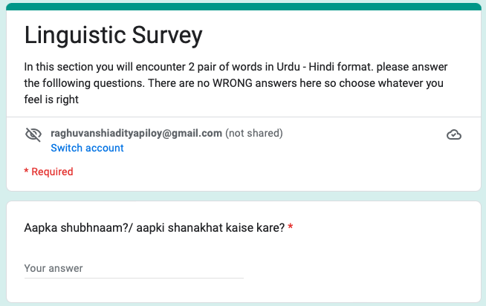
Stage 1
Aim – to find out whether the feeling is lost in translating languages or not. We mainly focused on Urdu and Hindi in our survey.

Slide 6
Stage 1
Someone please ask: How we tried to reduce observers' paradox ?
Methodology :
Section 1: word by word survey where word were given in both Hindi and Urdu and the participant was asked which was more soothing
Section 2 : Translating from Urdu to Hindi and surveying about the feeling that it’s trying to convey is getting affected by translation.
Section 3 : Hindi to Urdu and doing the same survey as above

Slide 7
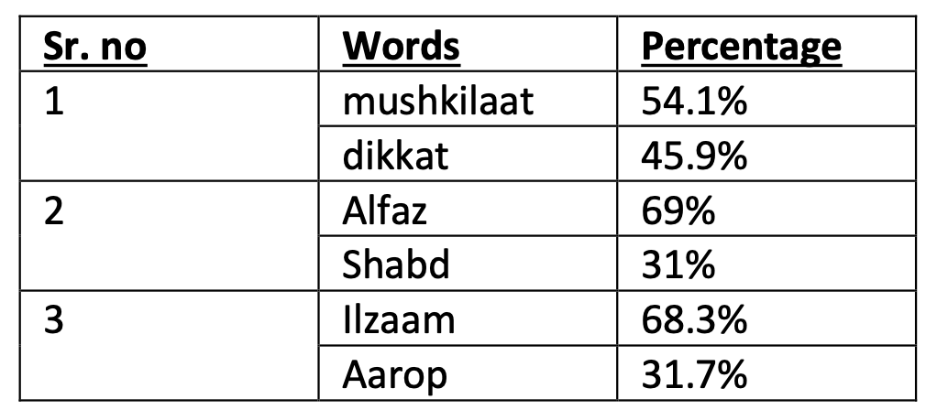
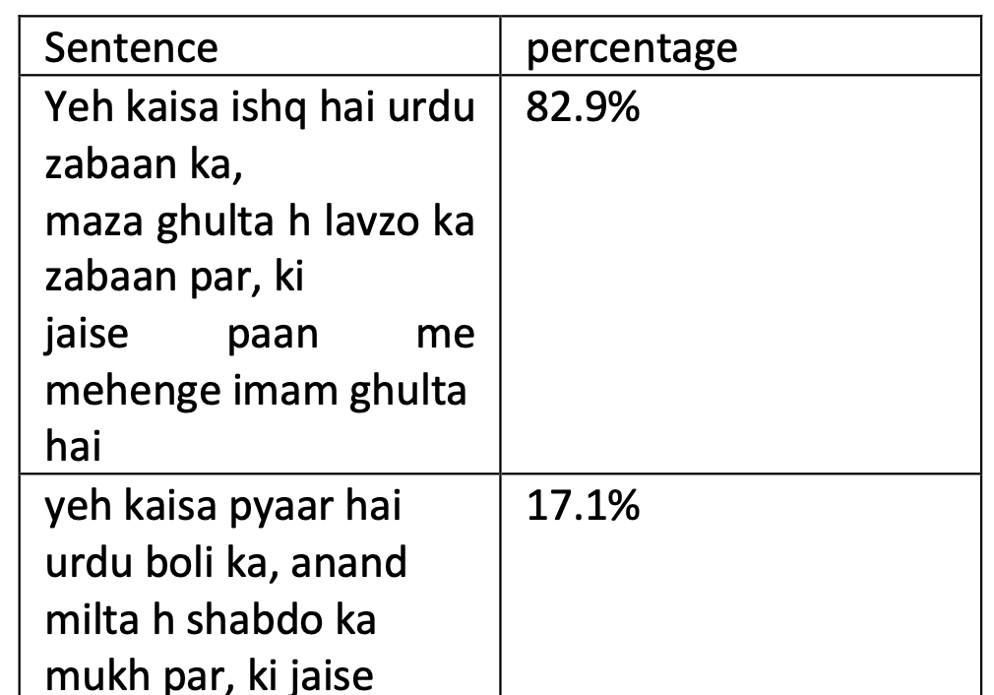
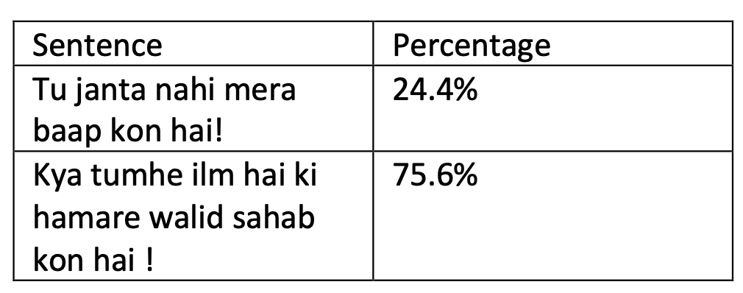
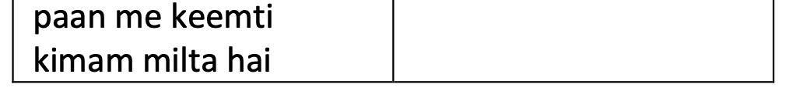
Stage 1
Results and findings && Conclusions :

Slide 8

Why stage 2 ?
Linguistically we know that no language is superior or inferior, all langauges do have similar features and incorporate similar traits.
So there is no semantic relation to a language being soothing or not. And moreover the languages are also rated by people who don’t know that language.
So we went for phonological analysis to find the root reason for our hypothesis.

Slide 9
Stage 2
Aim – To analyze the phonological differences between the languages which are perceived to sound sweet and which are not.

Slide 10
Stage 2
Methodology :
We gathered our data from the analysis of research papers of different languages about the frequency-wise distribution of various phonetic sounds available in it. We plotted the frequencies, converting them from their way of representing sound to respective IPA symbols.
Analyse the frequency of vowels and consonants appearing in the language.

Slide 11
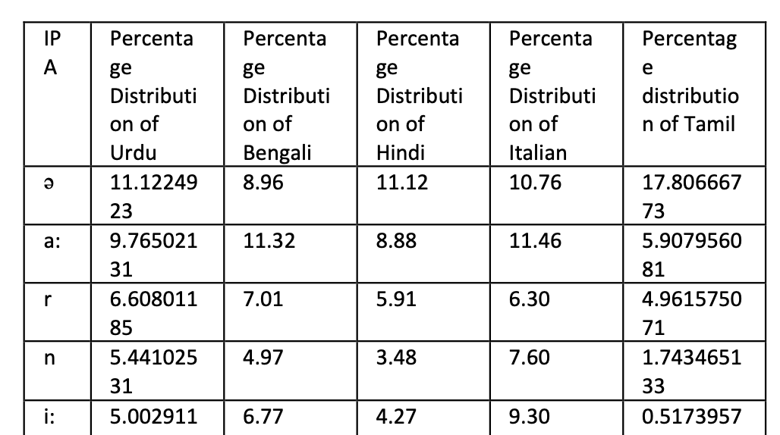
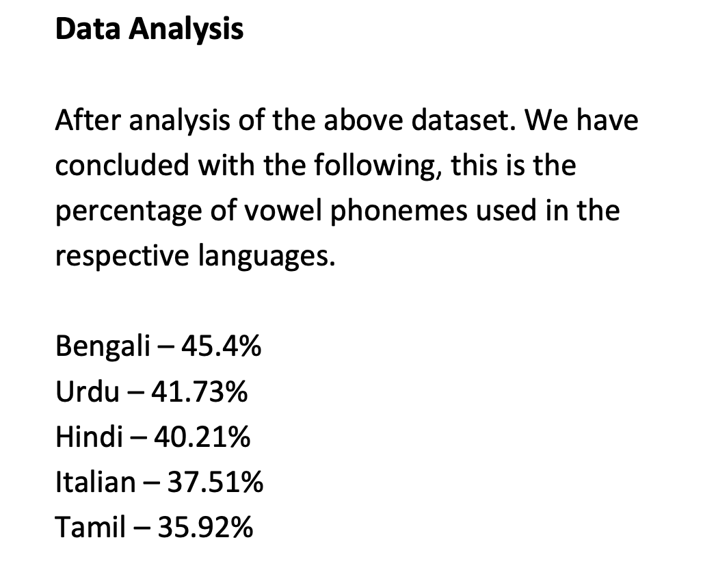
Stage 2

Slide 12
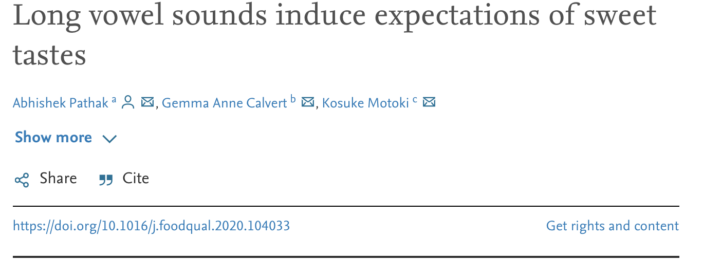
Stage 2
Conclusions :
We found that number of vowels occurring in a language which we are perceived to be sweet are more.

Slide 13
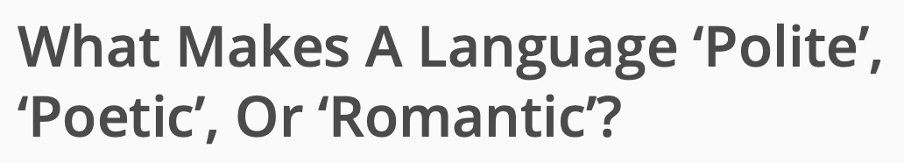
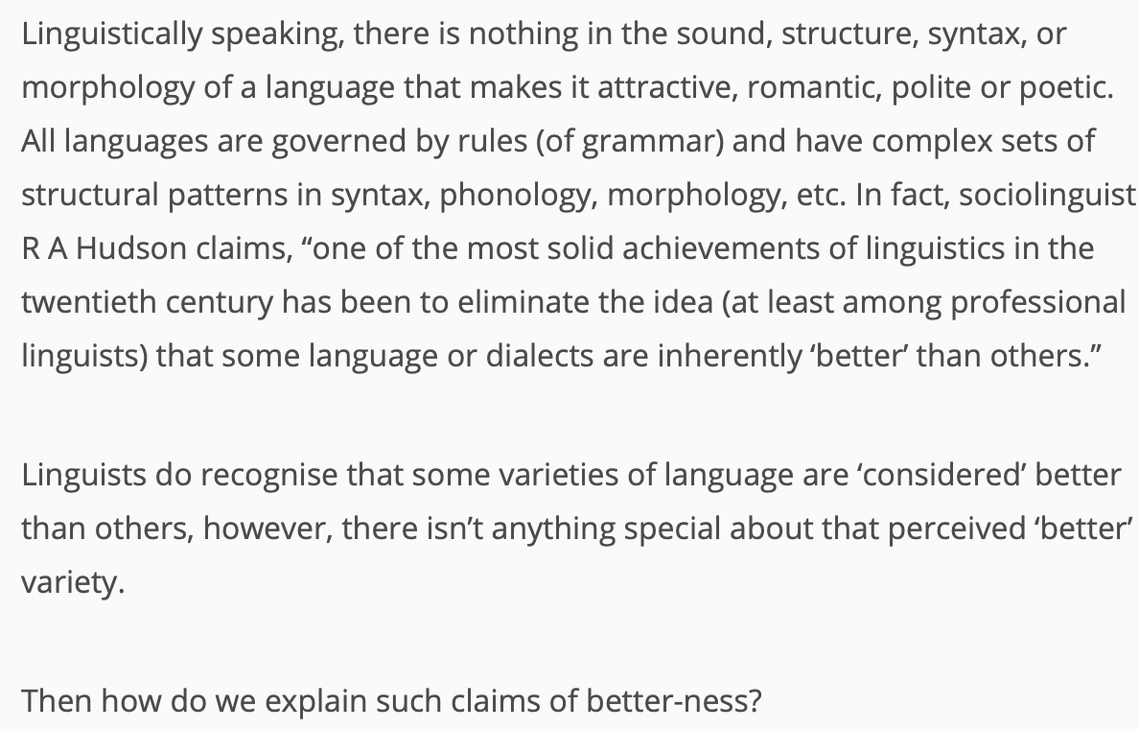
WHY STAGE 3

Slide 14


Slide 15
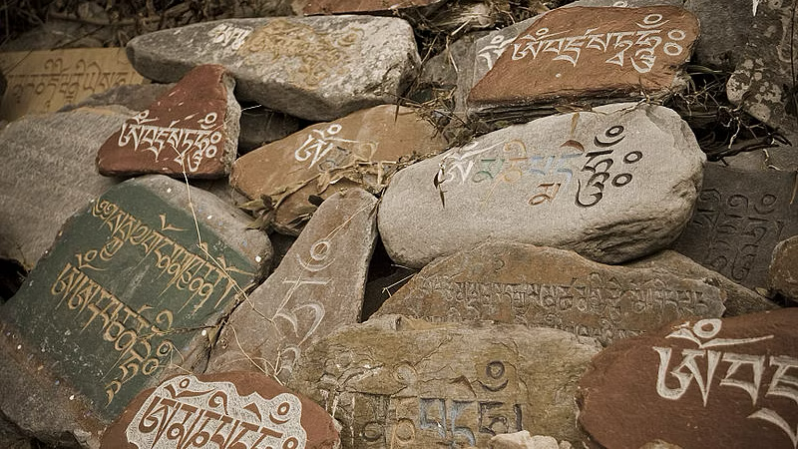
Stage 3
Stage 3 is our analysis of languages based on society and the perspective of common people.
The basic idea of the experiment revolved around the sociolinguistic fact that, the beauty and such face features and characteristics of the language are perceived by the hearer on the basis of the preconceived image of the original speakers of the language.

Slide 16
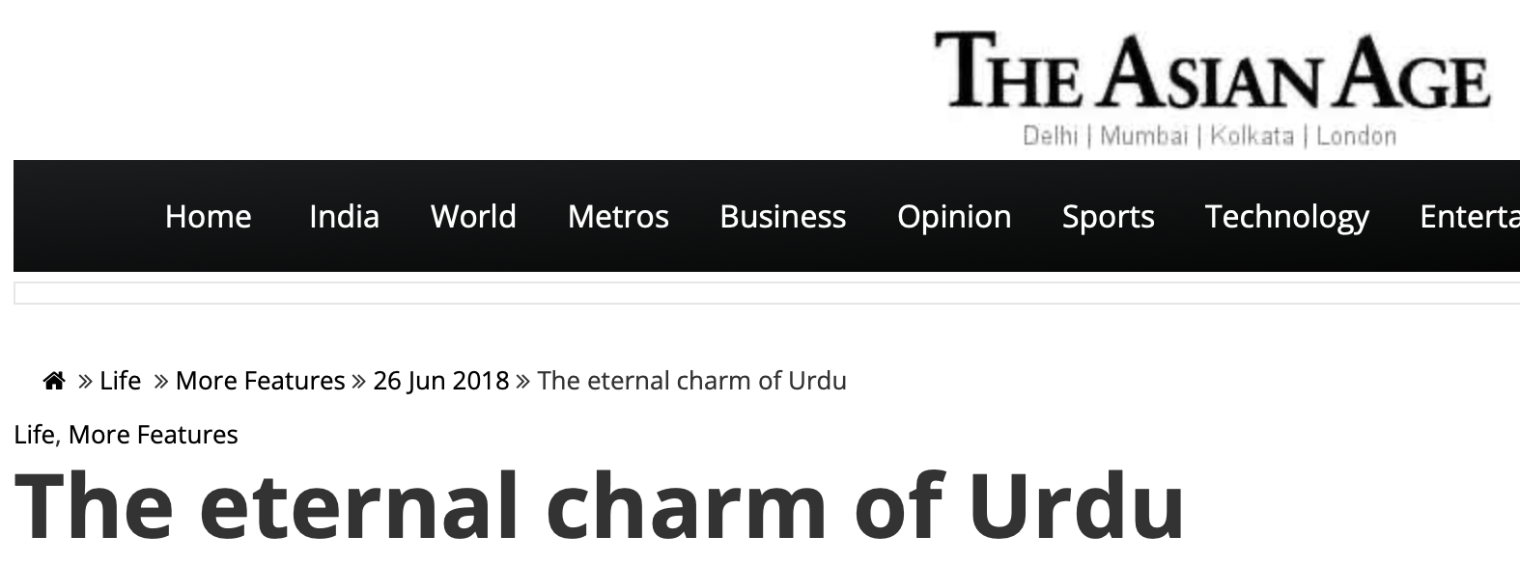
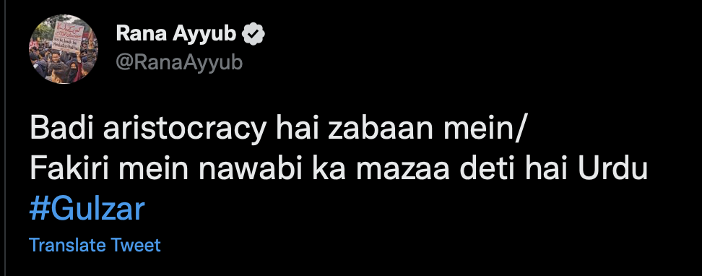

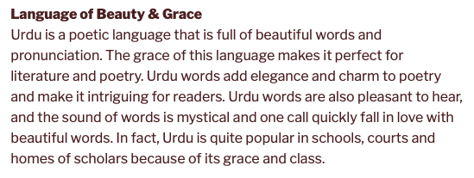
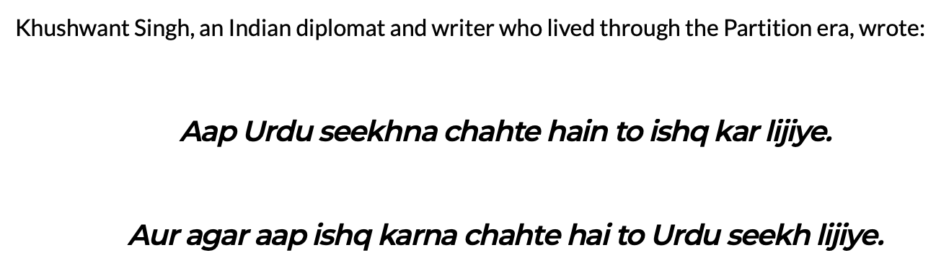
Stage 3

Slide 17
Final conclusion
Our initial hypothesis that some Indian languages sound more soothing than others is proved, mainly Urdu in this case.
The point that we made in stage 2 also points to the same conclusion but yet due to lack of sufficient research works on this topics, It’s conclusion are not majorly considered for the proof of our hypothesis.
We can say on the basis of the discussion which were made in stage 3 of our project that from common person’s perspective, Urdu is more soothing than other Indian Languages.

Slide 18
Bibliography
https://docs.google.com/forms/d/e/1FAIpQLScK0F eaqKtx2QYr3JU6b9AEwaSfYtRVdIxZ5y2v4xPOoR9s 4w/viewform?usp=sf_link
https://ajammc.com/2021/08/01/urdu-instagram-poetry/
https://swarajyamag.com/culture/what-makes-a-language-polite-poetic-or-romantic
https://www.languageoasis.com/blog/all-that-you-wanted-to-know-about-the-urdu-language/
https://www.asianage.com/life/more-features/260618/the-eternal-charm-of-urdu.html
https://twitter.com/ranaayyub/status/817815095468290049?lang=en
https://www.theguardian.com/education/2014/jul/17/what-makes-a-language-attractive
https://youtu.be/d22JtTJtFdw
https://www.sciencedirect.com/science/article/abs/pii/S0950329320303025
https://www.livemint.com/Opinion/B9PWW3liEjY 59D4Y1IGYkL/The-romance-of-Urdu-is-lost-in- translation.html
https://www.livemint.com/Opinion/B9PWW3liEjY 59D4Y1IGYkL/The-romance-of-Urdu-is-lost-in- translation.html
https://www.oxfordbibliographies.com/view/docu ment/obo-9780199772810/obo-9780199772810- 0161.xml#:~:text=Linguistic%20politeness%20can %20be%20defined,what%20society%20or
https://en.wiktionary.org/wiki/Appendix:Hindi_pr onunciation
https://www.sttmedia.com/characterfrequency- hindi
Haris Bin Zia1, Agha Ali Raza1, Awais Athar2 PronouncUR: An Urdu Pronunciation Lexicon Generator EMBL-EBI, Wellcome Genome Campus, Hinxton, Cambridgeshire, CB10 1SD, UK
https://www.sttmedia.com/characterfrequency- italian
Estimation of the Frequency of Occurrence of Italian Phonemes in Text J. Arango*, A. DeCaprio*, S. Baik†, L. De Nardis‡, S. Shattuck-Hufnagel† and M.-G. Di Benedetto*†‡
Thennarasu Sakkan Corpus : https://www.academia.edu/8745513/A_Statistical _Study_of_Tamil_Corpus
Ferguson, Charles A., and Munier Chowdhury. “The Phonemes of Bengali.” Language, vol. 36, no. 1, 1960, pp. 22–59. JSTOR, https://doi.org/10.2307/410622. Accessed 17 Nov. 2022.

Slide 19


